Slide 1
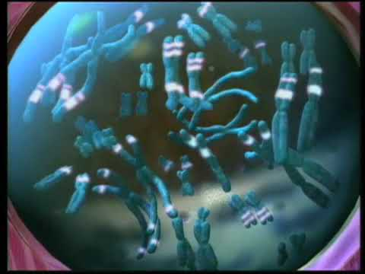
SEL Part #1

Slide 2
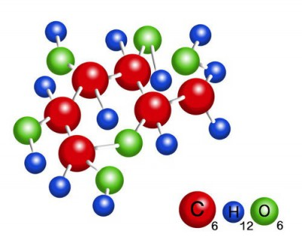
Kimia Kehidupan
Pertemuan 2

Slide 3
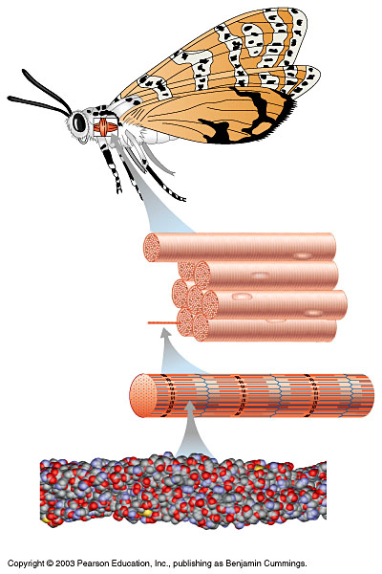
Hirarki Biologi
D. Organ: Flight muscle of a moth
Rattlebox moth
C. Cell and tissue: Muscle cell within muscle tissue
Myofibril (organelle)
B. Organelle: Myofibril (found only in muscle cells)
Actin
Myosin
A. Molecule: Actin
Atom

Slide 4
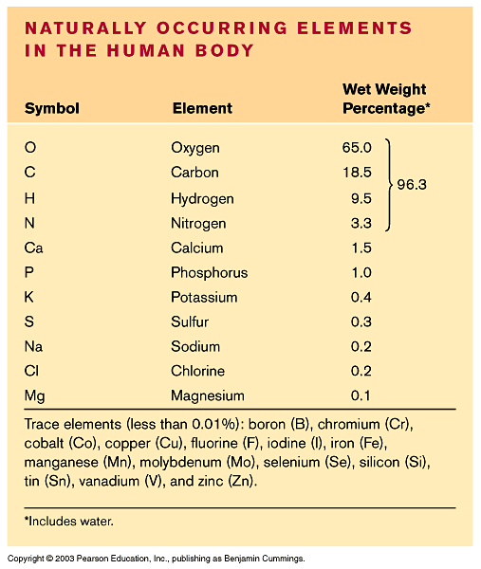
Elemen Kimia Penyusun Kehidupan
25 Elemen Penyusun Kehidupan
Karbon, hidrogen, oksigen, dan nitrogen merupakan penyusun dari sebagian besar materi hidup
Elemen lainnya juga diperlukan untuk proses kehidupan

Slide 5
Penyakit Goiter disebabkan karena kekurangan yodium??

Slide 6
Na
Sodium atom
Cl
Chlorine atom
Na⁺
Sodium ion
Cl–
Chloride ion
Atom
Senyawa
Elemen
Molekul
Sodium chloride (NaCl)
Ikatan Ionik
Ikatan Kovalen
Ikatan Ionik + Kovalen

Slide 7
Garam (NaCl)

Slide 8
Substansi Kehidupan
KARBOHIDRAT
LEMAK
PROTEIN
C + H + O
Sumber energi
C + H
C + O + N + S
Gula
Tepung & Glikogen
Cadangan energi
Minyak
Gliserol & asam lemak
Satuan penyusun tubuh
Dihasilkan dari metabolisme
Tersusun dari asam amino

Slide 9
KARBOHDRAT
Karbohidrat merupakan molekul
Karbohidrat paling sederhana adalah gula yang disebut sebagai monosakarida (glukosa, fruktosa)
Dua molekul monosakarida dapat bergabung membentuk disakarida (sukrosa)
Molekul karbohidrat yang lebih besar lagi adalah Polisakarida (tepung, selulosa, glikogen), dimana satu polimer tersusun atas lebih dari 2 molekul monosakarida

Slide 10
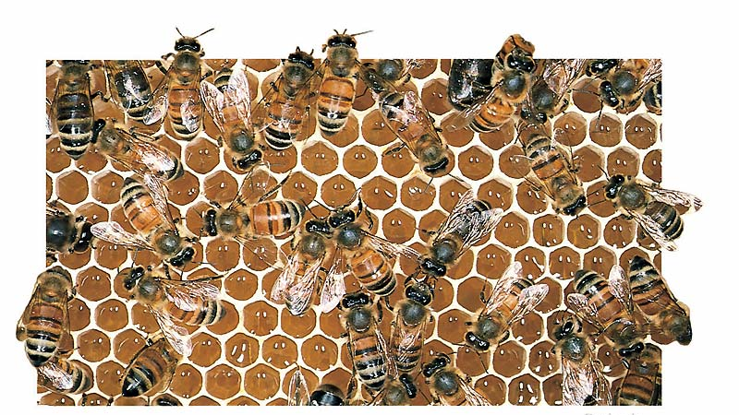
MONOSAKARIDA
Merupakan satuan unit terkecil dari gula
Biasanya tersusun dari rangkaian CH₂O atau kelipatannya
Setiap molekul mengandung gugus hydroxyl dan satu gugus carbonyl
Monosakarida merupakan sumber energi bagi aktivitas seluler
Figure 3.4A

Slide 11
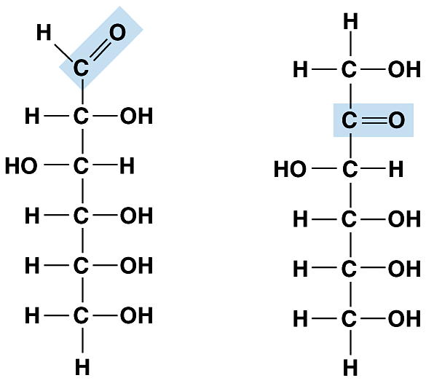
Monosakarida glukosa and fruktosa merupakan suatu isomer
Mempunyai atom yang sama akan tetapi susunannya berbeda
Figure 3.4B
Glucose
Fructose

Slide 12
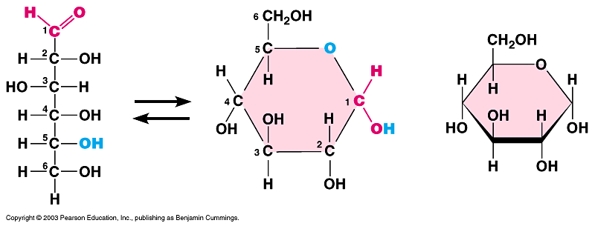
Beberapa monosakarida membentuk gugus siklis (glukosa)
Abbreviated structure
Figure 3.4C

Slide 13
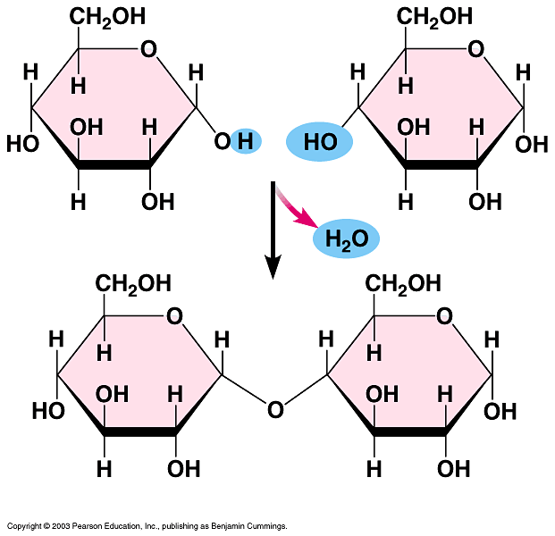
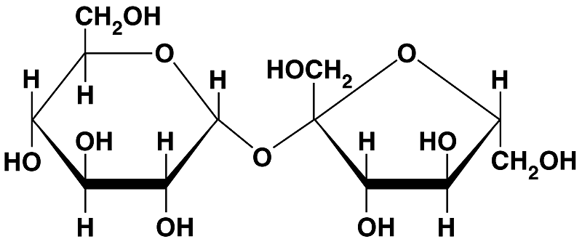
3.5 Cells link single sugars to form disaccharides
Monosaccharides can join to form disaccharides, such as sucrose (table sugar) and maltose (brewing sugar)
Glucose
Glucose
Sucrose
Figure 3.5
Maltose

Slide 14
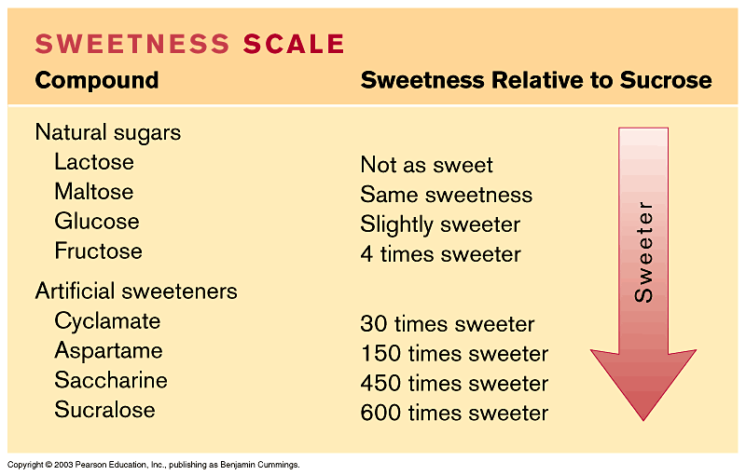
3.6 Connection: How sweet is sweet?
Various types of molecules, including non-sugars, taste sweet because they bind to “sweet” receptors on the tongue
Table 3.6

Slide 15
Polysaccharides are long chains of sugar units
These large molecules are polymers of hundreds or thousands of monosaccharides linked by dehydration synthesis

Slide 16
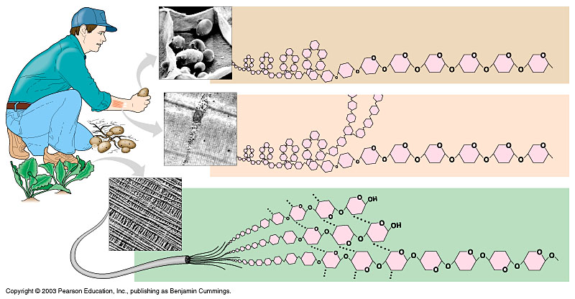
Starch and glycogen are polysaccharides that store sugar for later use
Cellulose is a polysaccharide in plant cell walls
Starch granules in potato tuber cells
Glucose monomer
STARCH
Glycogen granules in muscle tissue
GLYCOGEN
Cellulose fibrils in a plant cell wall
CELLULOSE
Cellulose molecules
Figure 3.7

Slide 17
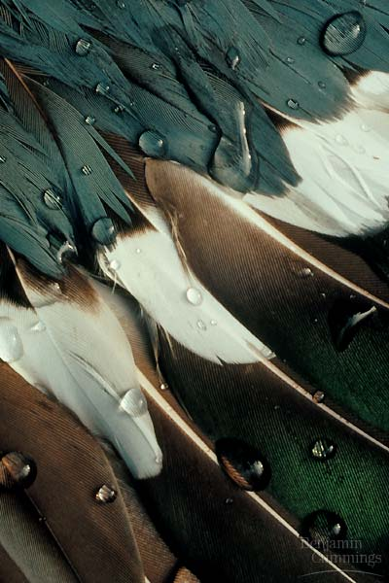
Lipids include fats, which are mostly energy-storage molecules
These compounds are composed largely of carbon and hydrogen
They are not true polymers
They are grouped together because they do not mix with water
Figure 3.8A

Slide 18
Fats are lipids whose main function is energy storage
They are also called triglycerides
A triglyceride molecule consists of one glycerol molecule linked to three fatty acids
Fatty acid
Figure 3.8B

Slide 19
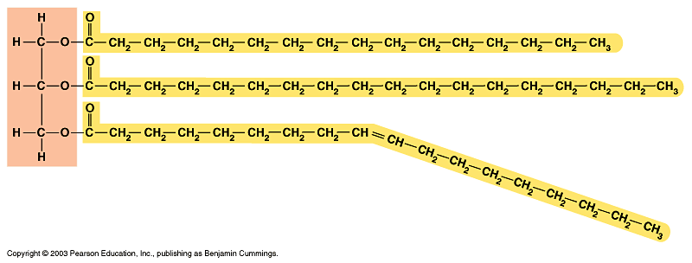
The fatty acids of unsaturated fats (plant oils) contain double bonds
These prevent them from solidifying at room temperature
Saturated fats (lard) lack double bonds
They are solid at room temperature
Figure 3.8C

Slide 20
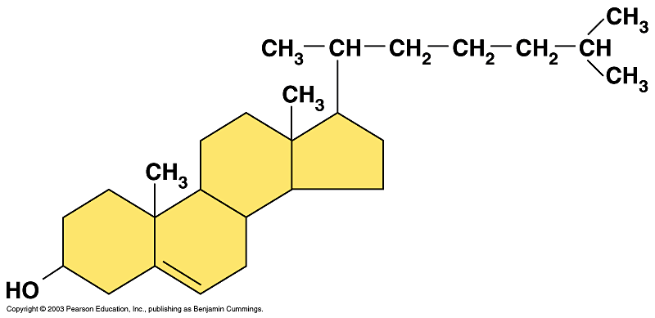
Phospholipids, waxes, and steroids are lipids with a variety of functions
Phospholipids are a major component of cell membranes
Waxes form waterproof coatings
Steroids are often hormones
Figure 3.9

Slide 21
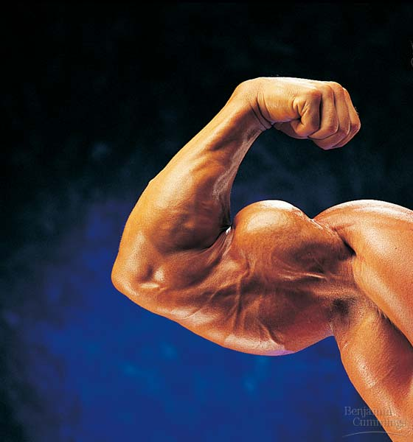
Connection: Anabolic steroids and related substances pose health risks
Anabolic steroids are usually synthetic variants of testosterone
Use of these substances can cause serious health problems
Figure 3.10

Slide 22
PROTEINS
3.11 Proteins are essential to the structures and activities of life
Proteins are involved in
cellular structure
movement
defense
transport
communication
Mammalian hair is composed of structural proteins
Enzymes regulate chemical reactions
Figure 3.11

Slide 23
Proteins are made from just 20 kinds of amino acids
Proteins are the most structurally and functionally diverse of life’s molecules
Their diversity is based on different arrangements of amino acids

Slide 24
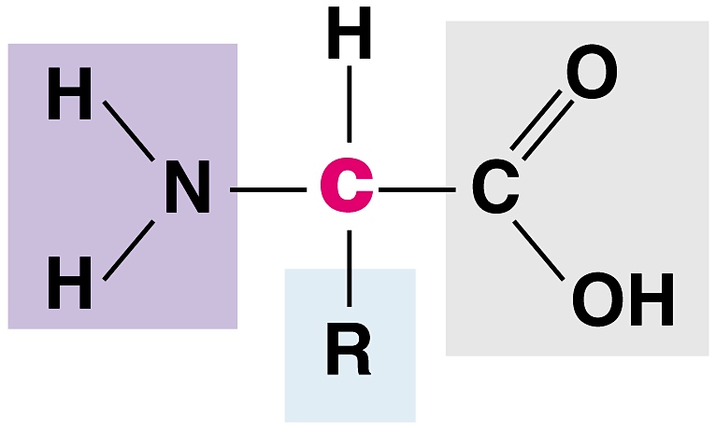
Each amino acid contains:
an amino group
a carboxyl group
an R group, which distinguishes each of the 20 different amino acids
Amino group
Carboxyl (acid) group
Figure 3.12A

Slide 25
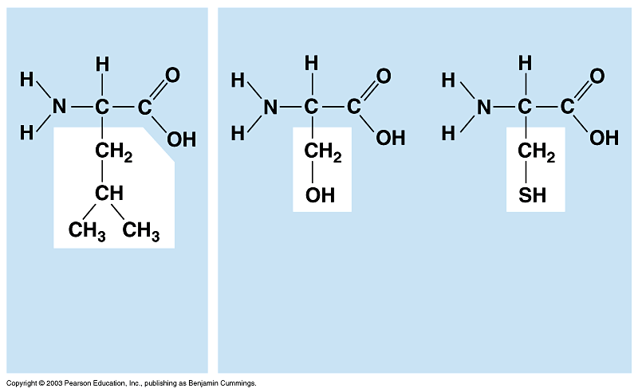
Each amino acid has specific properties
Leucine (Leu)
Serine (Ser)
Cysteine (Cys)
HYDROPHOBIC
HYDROPHILIC
Figure 3.12B

Slide 26
Amino acids can be linked by peptide bonds
Cells link amino acids together by dehydration synthesis
The bonds between amino acid monomers are called peptide bonds
Carboxyl group
Amino group
PEPTIDE BOND
Dehydration synthesis
Amino acid
Amino acid
Dipeptide
Figure 3.13

Slide 27
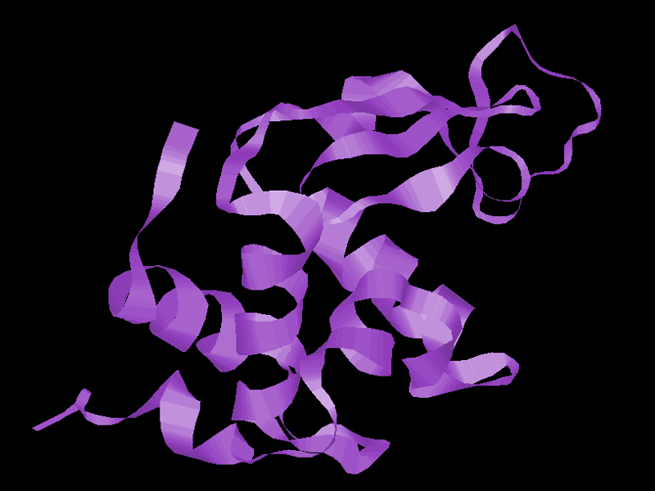
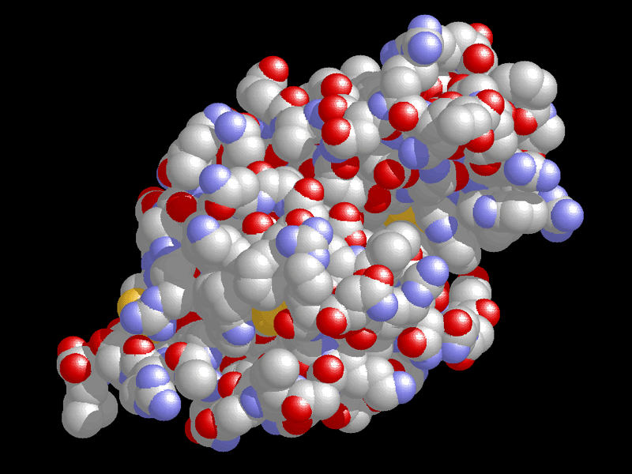
Overview: A protein’s specific shape determines its function
A protein, such as lysozyme, consists of polypeptide chains folded into a unique shape
The shape determines the protein’s function
A protein loses its specific function when its polypeptides unravel
Figure 3.14A
Figure 3.14B

Slide 28
3.15 A protein’s primary structure is its amino acid sequence
3.16 Secondary structure is polypeptide coiling or folding produced by hydrogen bonding
Primary structure
Amino acid
Secondary structure
Hydrogen bond
Pleated sheet
Alpha helix
Figure 3.15, 16

Slide 29
3.17 Tertiary structure is the overall shape of a polypeptide
3.18 Quaternary structure is the relationship among multiple polypeptides of a protein
Tertiary structure
Polypeptide (single subunit of transthyretin)
Quaternary structure
Transthyretin, with four identical polypeptide subunits
Figure 3.17, 18

Slide 30
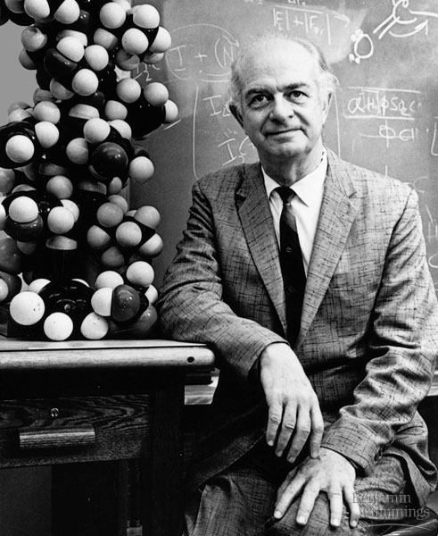
Talking About Science: Linus Pauling contributed to our understanding of the chemistry of life
Pauling made important contributions to our understanding of protein structure and function
Figure 3.19

Slide 31
NUCLEIC ACIDS
3.20 Nucleic acids are information-rich polymers of nucleotides
Nucleic acids such and DNA and RNA serve as the blueprints for proteins
They ultimately control the life of a cell

Slide 32
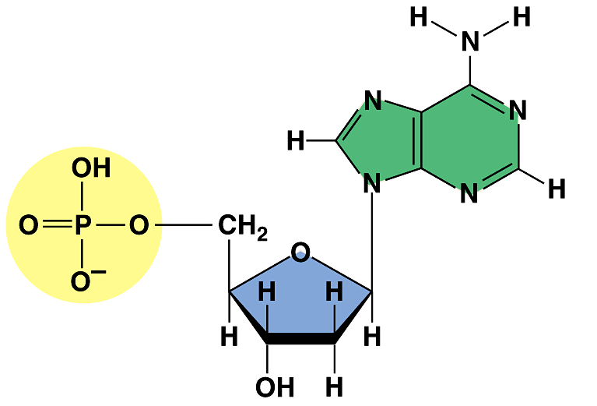
The monomers of nucleic acids are nucleotides
Each nucleotide is composed of a sugar, phosphate, and nitrogenous base
Nitrogenous base (A)
Phosphate group
Figure 3.20A
Sugar

Slide 33
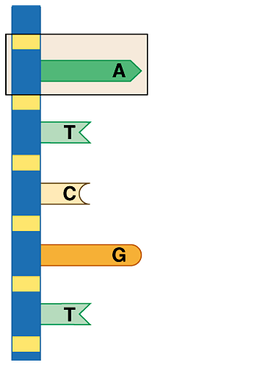
The sugar and phosphate form the backbone for the nucleic acid
Nucleotide
Sugar-phosphate backbone
Figure 3.20B

Slide 34
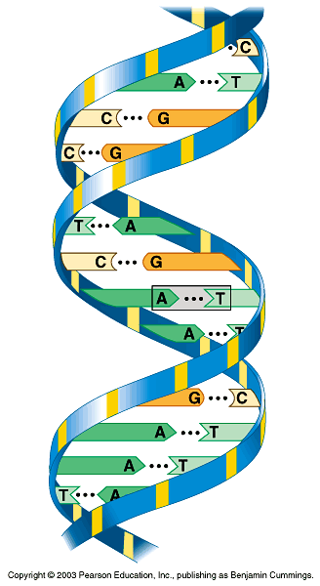
DNA consists of two polynucleotides twisted around each other in a double helix
The sequence of the four kinds of nitrogenous bases in DNA carries genetic information
Base pair
Nitrogenous base (A)
Figure 3.20C

Slide 35
Stretches of a DNA molecule called genes program the amino acid sequences of proteins
DNA information is transcribed into RNA, a single-stranded nucleic acid
RNA is then translated into the primary structure of proteins

